Slide 1
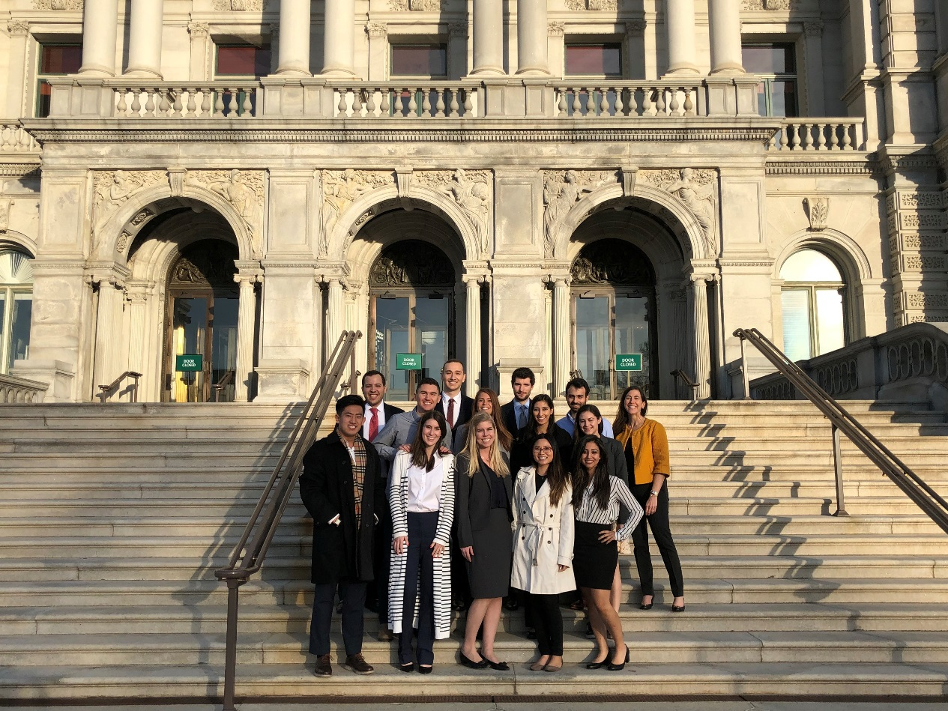
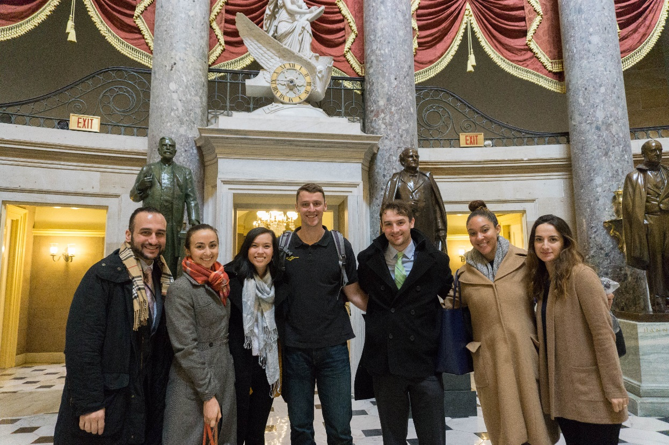
University of California Law Program in DC (UCDC Law Program) Spring 2022 Information Session

Slide 2
Program Overview
Full Semester (15 weeks in DC – includes Thanksgiving week in the fall and Spring break in the spring) *
13 credits (10 placement pass/fail; 3 seminar graded) *
Fall and Spring Only
Classroom and externship
Special Programming – Supreme Court Tour, Capitol Tour, White House Tour, Alumni Career Panel, UC Law Alumni Happy Hours
* Spring 2022 options are being considered on a case-by-case basis.

Slide 3
Externship Component
Work 40 hours per week for min. 14 weeks or 560 hours (Even if you work fewer hours, 14 week min. is still required)
Extern with federal government, non-profit or advocacy organization, or Hill
Must be supervised by JD and engaged in substantive legal-work for credit
All placements must be approved by Director of the program
10 credits for field placement (pass/fail) *
* Spring 2022 may allow Part-Time option. Requests are being considered on a case-by-case basis.

Slide 4
Seminar Component - Law and Lawyering in Nation’s Capital
3 credit mandatory seminar (graded)
Class meets on Tuesday evenings from 6-9 pm ET
Explores the roles of attorneys in Washington, D.C.
Almost weekly high-level guest lecturers from Executive Branch, Legislative, Judicial, and Public Interest
Puts the work at your placement in context
Class includes a 4 writing assignments and final oral presentation

Slide 5
Current UCDC Law Experience
General temperature in DC re: Covid
Coffee meetings
Client meetings
Site visits
Some students at the office

Slide 6
Registration Process: Three Steps
Step One: Apply to the Program Itself
Confirm with your school that you are eligible and have permission to apply:
Learn your school’s externship policies
Generally, fourth, fifth, and sixth semester students are eligible
Obtain the approval of the Dean of Student Services or equivalent
Complete the on-line UCDC Law Registration (found on UCDC Law Webpage - https://www.ucdc.edu/academic/law)
Step Two: Apply to the Placements that Interest You
Schedule advising session with UCDC Law Program Director
Placement must meet the following requirements:
Your placement must provide substantive legal work under a lawyer’s supervision, with regular feedback, mentorship, and insulation from purely clerical or administrative work.
Stay in touch with UCDC Law Program Director
Step Three: After an Offer
Inform Program Director to obtain approval.
Once the placement is approved, the Program will notify your school and you will be permitted to register for the placement and companion course.

Slide 7
Security Clearances
All federal government agencies require a security clearance as part of the application process. (Externships on the Hill do not require a security clearance)
This can be a lengthy process
Apply with as much lead time as possible, even if there’s no stated deadline
Obtain Security Clearance Forms
Ask about your agency’s security clearance process. Request forms and submit all forms ASAP.
Ask HOW you should submit your form. Mail has been delayed with COVID.
Common issues that cause delays:
Travel abroad within past 5 years
Dual citizenships
Late credit card or student loan payments
Any arrests
Illegal drug use

Slide 8
Eligibility Requirements - Berkeley
Berkeley Law students must be in their fourth, fifth or sixth semesters of law school to participate in the Program.
If you plan to do your field placement for 10-12 units, Berkeley Law students must confirm with the Student Services Office that they are eligible to participate in a full-time program in terms of units, course requirements, and other academic planning issues.
Students must confirm that they have enough externship/non-classroom units available to participate. There is an 18 unit cap on non-classroom units. Please refer to Academic Rule 3.1(c) and Rule 5.
*The 3 accompanying class units do not come out of the non-classroom units.

Slide 9
Eligibility Requirements – Hastings
Hastings Law students must be in their fourth, fifth or sixth semesters of law school to participate in the Program.
Hastings students must confirm eligibility with the Associate Dean for Experiential Learning in terms of units, course requirements, and other academic planning issues.
The 3 unit seminar, “Law and Lawyering in the Nation’s Capital” and the fieldwork are each graded CR/NC.
Students must confirm that they have enough non-classroom units available to participate. There is a 20 unit cap on non-classroom units (independent study, TA, RA, competition team, journal, note, non-class or fieldwork portion of clinics and externships); please refer to Academic Reg. 1203.

Slide 10
Eligibility Requirements – Davis
Davis Law students must be in their fourth, fifth or sixth semesters of law school to participate in the Program.
UC Davis Law students must check their unofficial transcripts and are encouraged to meet with the Dean of Students to confirm that they are eligible to participate in the program in terms of units, course requirements and other academic planning issues.
UC Davis Law Students must confirm that they have enough externship/clinical units to participate. No more than 16 units of courses (up to 20 units with permission) numbered 400 or above (including the UCDC externship) and non-law courses at any UC may be taken for credit towards King Hall J.D. See Regulation 1.4(B)(3). No more than 14 of these units may be taken in externships, including the UCDC externship. See Regulation. Note that the 3 unit seminar, “Law and Lawyering in the Nation’s Capital” is a graded course and is not included in the calculations of Regulation 1.4(B).

Slide 11
Eligibility Requirements – Irvine
Irvine Law students must be in their fourth, fifth or sixth* semesters of law school to participate in the Program.
* Irvine Law students in their sixth semester must obtain approval from Professor Hughes, UCI Law Externship Director.
UC Irvine Law students must confirm with the Dean of Students that they are eligible to participate in the program in terms of units, course requirements, limitations on particular types of units (see Academic Rules, I. D.) and other academic planning issues. Confirmation of this approval must be submitted (using the Externship Registration form) to the Director of Externships.

Slide 12
Eligibility Requirements – UCLA
UCLA Law students must be in their fourth, fifth or sixth semesters of law school to participate in the Program.
UCLA Law students must confirm with the UCLA Law Externship Office that they are eligible to participate in the Program in terms of units, course requirements, and other academic planning issues.
Students who have already participated in an externship are not eligible to apply.

Slide 13
Sample Placements – More samples listed on the UCDC Law Website
Senate Judiciary Committee
District Court for the District of Columbia
U.S. Department of Education
U.S. Department of Health and Human Services
U.S. Department of Justice
U.S. Department of State
U.S. Department of Treasury
U.S. Federal Trade Commission
U.S. Securities and Exchange Commission
White House
U.S. Department of Labor
CFTC
Non-Profit/NGOs
American Civil Liberties Unit (ACLU) - National Prison Project
American Council on Education, Office of General Council
D.C. Public Defender Service
NAACP Legal Defense Fund
Natural Resource Defense Council - Climate Policy Center
Robert F. Kennedy Center for Justice and Human Rights

Slide 14
Dates and Deadlines
Spring 2022
Spring 2022 application is available
Suggested Deadline: October 30
Start Date: January 17, 2022
Fall 2022
Fall 2022 application coming soon
Suggested Deadline: March 1, 2022
Start Date: TBD
* These dates are recommendations to maximize placement options. However, applications WILL be accepted after these dates.

Slide 15
Comments from Past Students
The UCDC law program was a dream come true for me. I was able to work in an ideal job placement, network with a wide and diverse variety of legal professionals, and explore the city in which I intend to practice after law school. I recommend it highly.
The UCDC law program was an incredibly practical and focused learning experience. I had the opportunity to develop the tools I need to be successful in the future. I came into law school with an idea od what I wanted to do after graduation and the Law Program gave me a better sense of how to achieve those goals.
The law program was helpful to My UCDC placement and contacts were extremely helpful in getting my job. I am fairly certain that I got the interview because of my FTC position because the firm had many ex-FTC lawyers. In addition, it was the references from my UCDC placement that vouched for me and really solidified the firm's decision to extend an offer.
Helped me develop and ground my interest in disability law and police misconduct work. The program did help me obtain my current fellowship experience because I gained so much relevant work experience while at the DOJ. My supervisor also provided me with a helpful recommendation letter for this position.
UCDC was one of the best experiences I've had in law school so far. While at the DOJ, my writing and research skills improved dramatically. My internship influenced my decision to apply for a clerkship after graduation, and I made wonderful professional connections while I was there.
I'm sure working at the White House has helped and will continue to help me. I got challenging, hands-on experience writing and thinking at intersections of law and policy; and, of course, "White House" is eye-catching. I made great friends through the program, atmospheric though that may be, both within and beyond the White House. I keep in touch with quite a few of them. I loved the weekly speakers, all of whom were engaging.
UCDC was incredibly helpful to me in obtaining my clerkship. During my externship with the Department of Justice, I was able to draft briefs and memorandums that allowed me to hone my appellate writing and research skills and demonstrate my interest in appellate work. I was able to work with people who had clerked across the country, and they provided me with insight and guidance on applying and went to bat for me with judges.

Slide 16
Contact Information
UCDC Law Program Nicole Lehtman Program Director Nicole.Lehtman@ucdc.edu (202) 974-6392 https://www.ucdc.edu/academic/law | UCLA Stephanie Davidson Director of Externships davidsons@law.ucla.edu (310) 206-4945 http://www.law.ucla.edu/centers-programs/clinical-program/externshiphome/UCDC/Pages/default.aspx | Berkeley Sue Schechter Field Placement Director sschechter@law.berkeley.edu (510) 643-7387 Kiara Williams Program Coordinator Kwilliams1@berkeley.edu https://www.law.berkeley.edu/experiential/field-placement-program/
Irvine D'lorah Hughes Director of Externships (949) 824-9809 dhughes@law.uci.edu http://www.law.uci.edu/current/ucdc_law.html | Hastings Nira Geevargis Associate Clinical Professor & Director, Externship Programs (415) 565-4600 geevargis@uchastings.edu https://www.uchastings.edu/academics/experiential-learning-opportunities/externships/ | Davis Dena Bauman Director of Externships and Lecturer in the Law (530) 752-3142 drbauman@ucdavis.edu https://law.ucdavis.edu/externships/

